Slide 1

9/6/19 Game Programming 1

Slide 2
Club Volunteers
Sponsorship relations
Git & Wiki maintainer
Github.com/elmtreecomputes/CreativeCodingClub
Website: http://www.melbournecoding.club/
Speakers

Slide 3
Club Activities 2019
Back to basic meetups
Internet of Things: Arduino, Raspberry Pi, ESP32
Game programming series
Computer Vision
Cross-specialisations
Member-to-member tutoring
Class room courses
Shared code repos:
Snippets of common operations in:
Python, Java, C, others

Slide 4
Club Activities 2019
Back to basic meetups
Internet of Things: Arduino, Raspberry Pi, ESP32
Game programming series
Cross-specialisations
Member-to-member tutoring
Class room courses
Shared code repos:
Snippets of common operations in:
Python, Java, C, others

Slide 5
Dipto Pratyaksa
Developer Relations @ PaperCut Software
15 years experience in Project Management, Programming, IT/Telco
Private tutoring

Slide 6
Tools and Environment
Code editor / Integrated Development Environment (IDE)
IDLE
VSCode
PyCharm
Terminal (Command Line Interpreter)

Slide 7
Game Programming Overview
Tools & Environment
Game design
2D game screen

Slide 8


Tools & Editor
Python 3 interpreter
PyGame

Slide 9
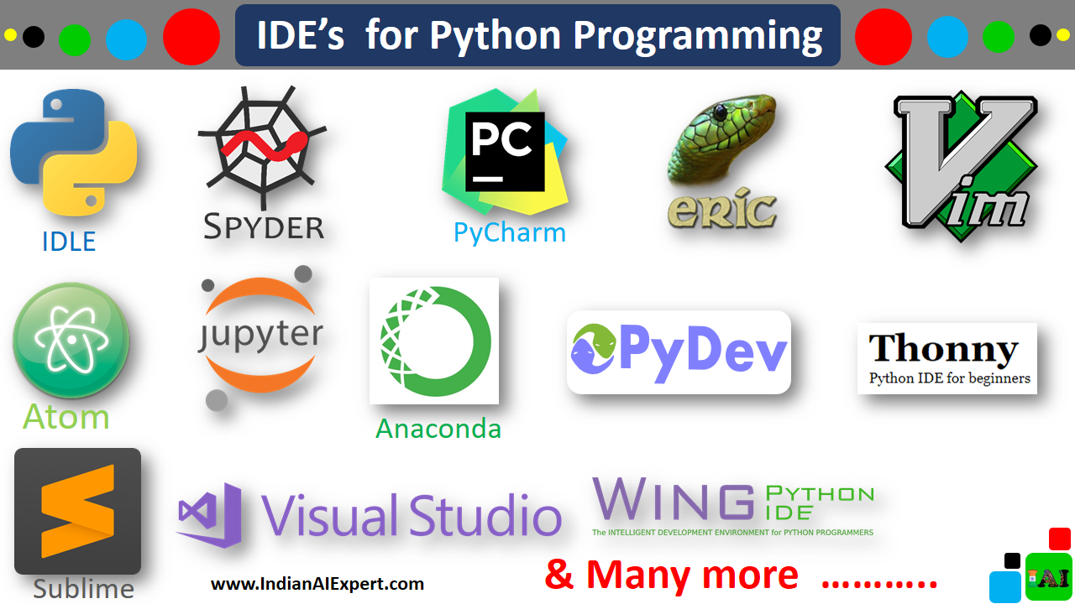

Slide 10
Other Supporting Tools
Graphics editor: GIMP / PhotoShop
Sound editor: audacity
Emulators / platform testers

Slide 11
PyGame Tutorials
http://thepythongamebook.com/en:pygame:step000
https://www.pygame.org

Slide 12
Pygame
Install pygame
pip3 install pygame
Run sample game
python3 -m pygame.examples.aliens

Slide 13
Game Genres
Adventure
Strategy:
Real Time Strategy (RTS)
Turn-based strategy
Role Playing Games
Puzzle
Board games
Sport
Simulators: Racing, driving, flights, boats,
Platformer (Side scroller)

Slide 14
Player modes
Single player
Multiplayer
VS or collaborative
Single console, networked, online
Mass multiplayers

Slide 15
Single player
Multiplayer
VS or collaborative
Single console, networked, online
Mass multiplayers

Slide 16
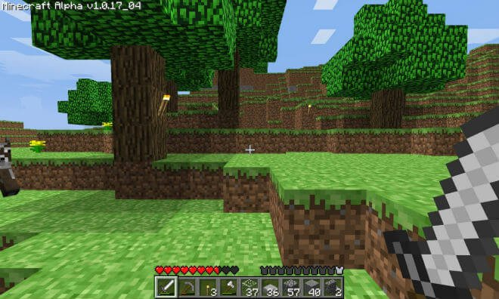
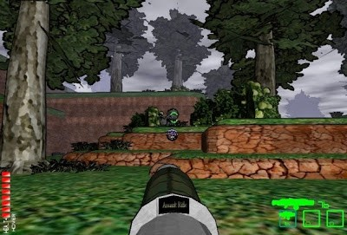
Game Perspective – First person

Slide 17
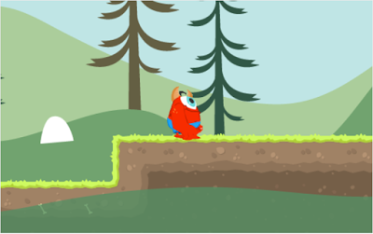
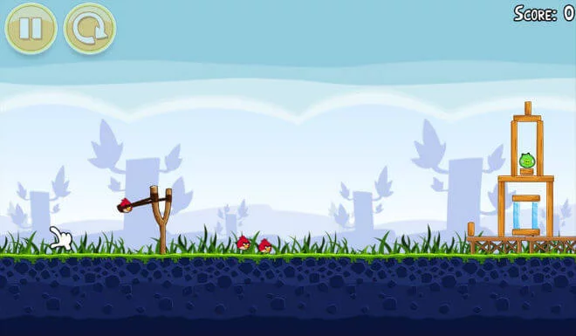
Game Perspective - 3rd person
Orthogonal / side scroller
Orthogonal / static stage

Slide 18
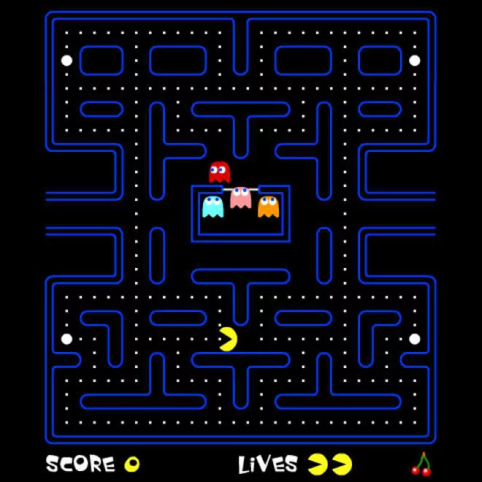
Third person – Top Down
Orthogonal – top down

Slide 19
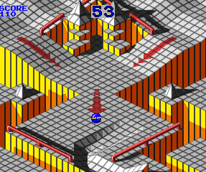
Third person - Isometric
Isometric
2.5d
3d drawn in 2d

Slide 20
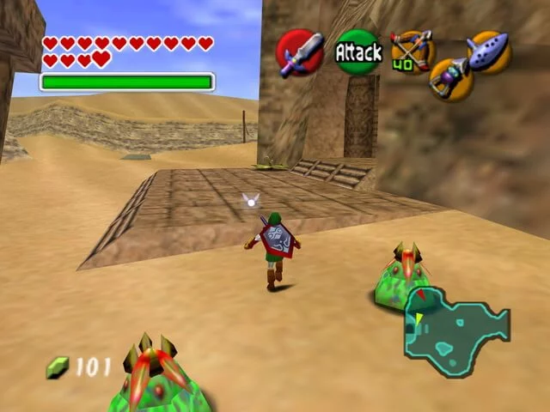
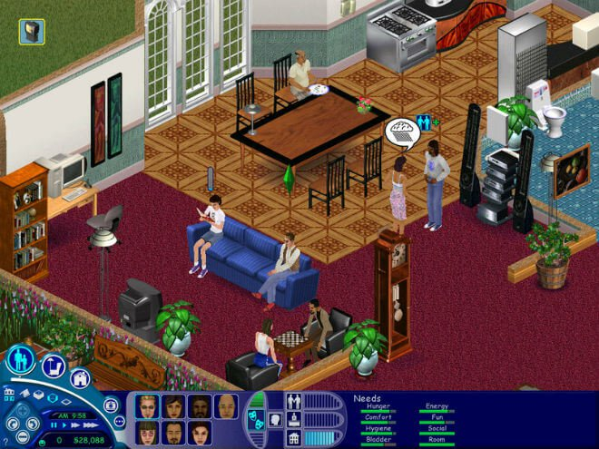
Third person 3D
“Follow me”
God view

Slide 21
Game Design Considerations
Ideas
Characters
Storyline
Environmental
Goals & objectives
Game controls
Bonuses
Addictiveness factor
Score systems
Platforms: Desktop / Console / Mobile / Internet
Player interactions

Slide 22
2D Screen System
Coordinate systems
Cartesian
Polar
Screen coordinate
0, 0 is top left corner
Your screen size is all you see

Slide 23
2D screen system
Simulate movements: Animate, move location
What is moving?
Characters
Enemies
Background?
The game world itself
Is it really moving? Or just change locations?

Slide 24
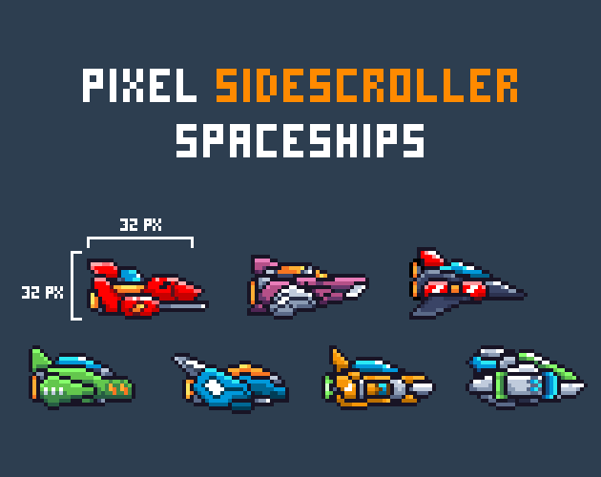
Draw your first 2D image on screen
Object
Size (length, width)
Coordinate (x, y)

Slide 25
Move it
Move what?
From where?
Current location
To where?
Destination

Slide 26
Move it (Algorithm)
Let shipA.X = 10
Let shipA.Y = 10
Draw shipA on X, Y
Erase shipA on X, Y
X = X + 1
Draw shipA on X, Y
Repeat

Slide 27
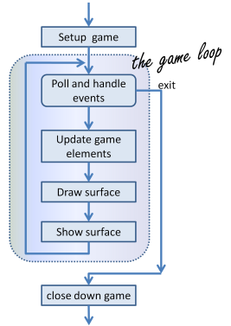
PyGame
http://openbookproject.net/thinkcs/python/english3e/pygame.html

Slide 28
import pygame
def main():
""" Set up the game and run the main game loop """
pygame.init() # Prepare the pygame module for use
surface_sz = 480 # Desired physical surface size, in pixels.
# Create surface of (width, height), and its window.
main_surface = pygame.display.set_mode((surface_sz, surface_sz))
# Set up some data to describe a small rectangle and its color
small_rect = (300, 200, 150, 90)
some_color = (255, 0, 0) # A color is a mix of (Red, Green, Blue)
while True:
ev = pygame.event.poll() # Look for any event
if ev.type == pygame.QUIT: # Window close button clicked?
break # ... leave game loop
# Update your game objects and data structures here...
# We draw everything from scratch on each frame.
# So first fill everything with the background color
main_surface.fill((0, 200, 255))
# Overpaint a smaller rectangle on the main surface
main_surface.fill(some_color, small_rect)
# Now the surface is ready, tell pygame to display it!
pygame.display.flip()
pygame.quit() # Once we leave the loop, close the window.
main()
http://openbookproject.net/thinkcs/python/english3e/pygame.html

Slide 29
Next meetup
Game controls
Sprite design

Slide 30
Game collections
https://itch.io/games/top-rated/made-with-pygame/tag-2d

